Slide 1
LOAN PREDICTION ANALYSIS
Predicting the Approval status of the loan using Machine Learning

Slide 2

INTRODUCTION
Many banks today, authorize loans after extensive verification and validation procedures. Nevertheless, there is no guarantee that the chosen customer is secure. Therefore, it is crucial to use a variety of approaches in the banking industry to choose customers who make loan payments on time. In this project, the goal is to forecast whether a loan will be authorized or denied based on the data such as applicant income, credit history, gender, and the number of dependents.

Slide 3
DATA SOURCE
This dataset was sourced from https://www.kaggle.com and this dataset has two .csv files (train.csv, test.csv). The train.csv dataset contains 614 rows and 13 columns and the size of the dataset is 37.1kb.

Slide 4
DATASET INFORMATION
Variable | Description | Datatype
Loan ID | Unique ID | Object
Gender | Male/Female | Object
Married | Marital Status | Object
Dependents | No.of. Dependents | Object
Education | Graduate/UG | Object
Self_Employed | Self Employed(Y/N) | Object
ApplicantIncome | Applicant Income | int64
CoApplicantIncome | CoApplicant Income | float64
Loan_Amount | Loan Amount in thousands | float64
LoanAmountTerm | Term in months | float64
Credit_History | Credit History | float64
Property_Area | Urban/ Semi Urban/ Rural | Object
Loan_Status | Status( Y/N) | Object
The train.csv file has 614 rows and 13 columns

Slide 5
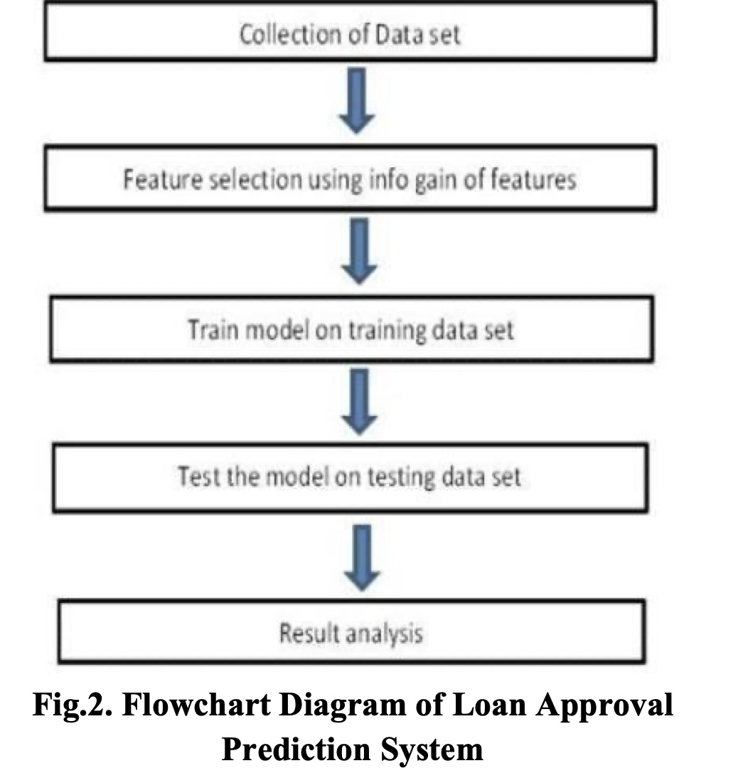
PLAN OF ACTION
Image Reference: https://innovation-journals.org/IV4i1-5.pdf

Slide 6
EXPLORATORY DATA ANALYSIS
No duplicate Values.
Filled all the null values by considering with the mean and mode of the columns( Mean: Integer, Median: Float).
Used Label Encoder to convert the required categorical variable to the numerical variable.

Slide 7
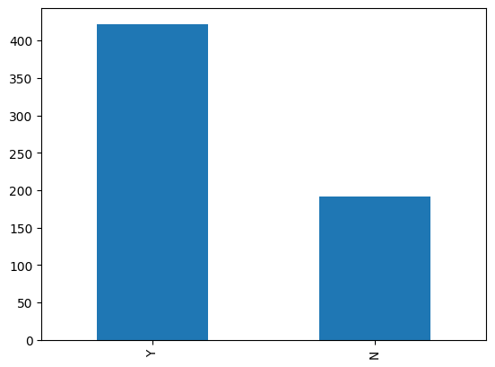
INSIGHTS
Around 70% of the Applicants has a clear chance of loan approval

Slide 8
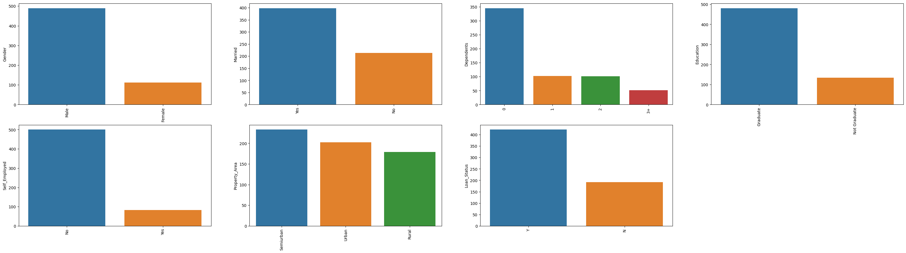
INSIGHTS
About 80% of Applicants are male and married.
Fair chance of loan approval is more towards the graduates and self employed.
Semi urban area residents has more chance for the approval

Slide 9
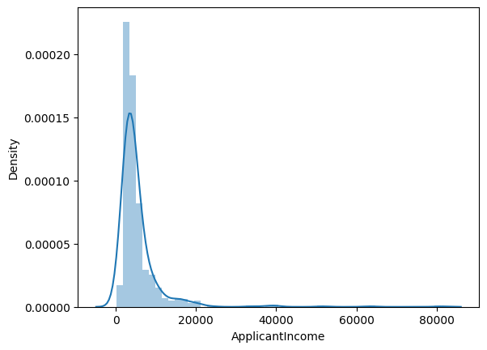
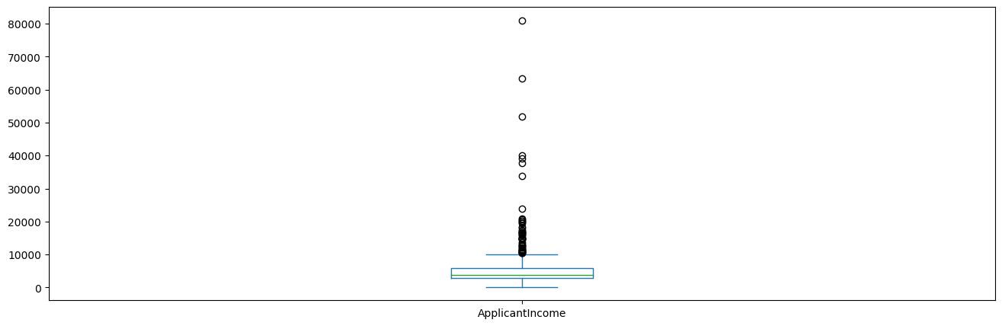
Frequency distribution for the numerical variable(Applicant Income and CoApplicant Income and checking the affect of this distribution on the Loan Status
The applicant income is normally distributed

Slide 10
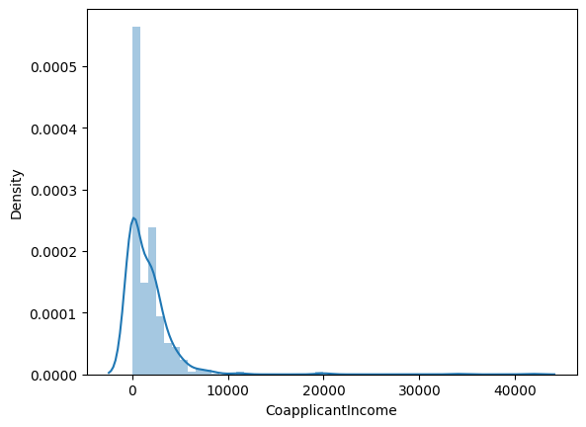
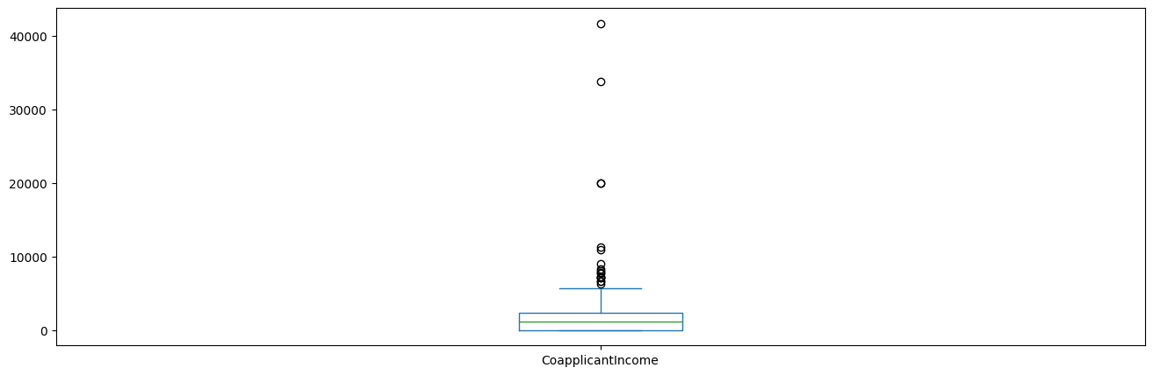
The CoApplicant Income is not normally distributed

Slide 11
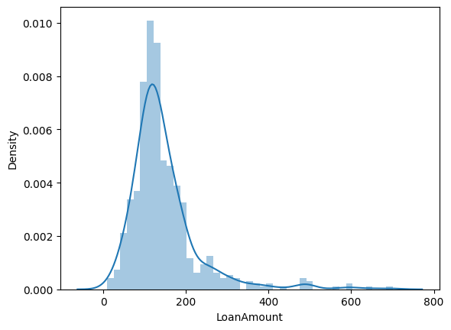
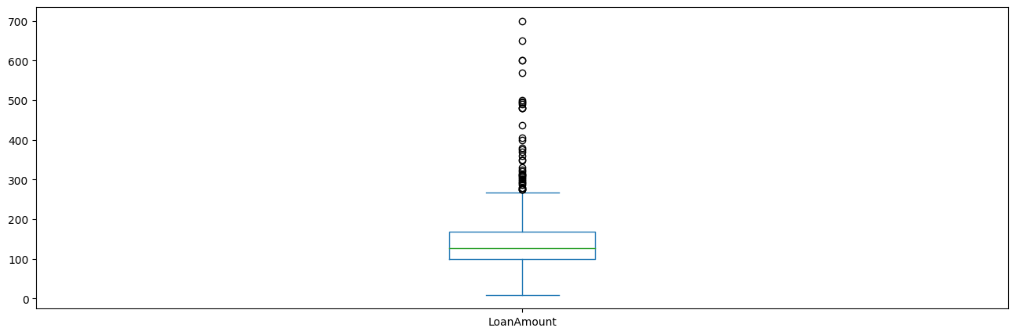
As the loan status is distributed normally, it can be inferred that the CoApplicant Income does not show much affect on the loan approval status

Slide 12
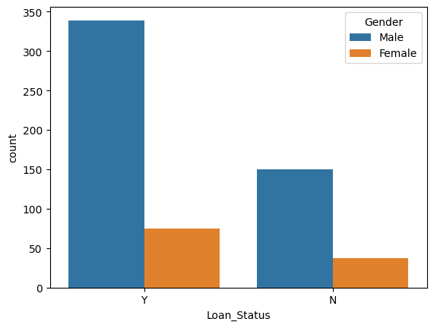
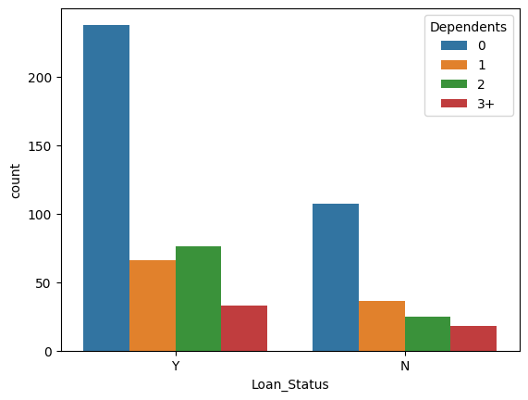
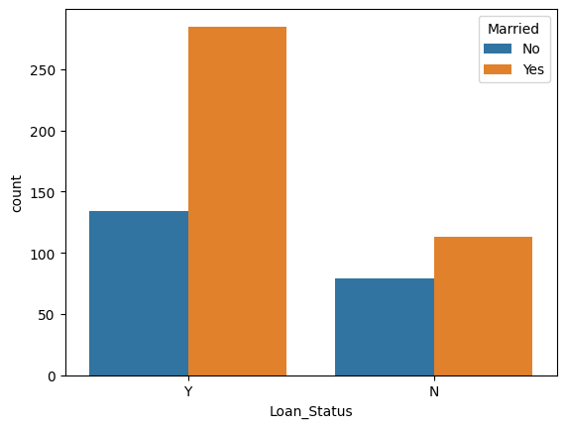
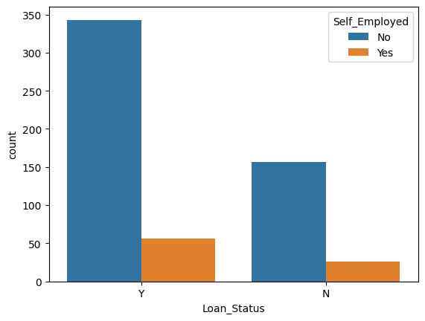
BIVARIATE ANALYSIS
The ratio of married applicants is higher
The proportion od dependents with 3+ is almost similar across the plot
Most of the self-employed applicants are on the positive chance of approval

Slide 13
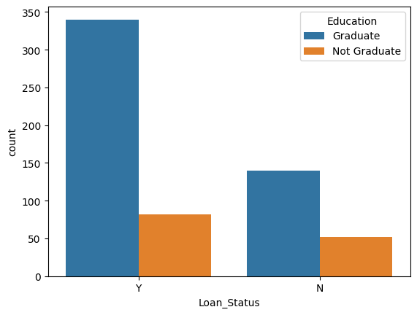
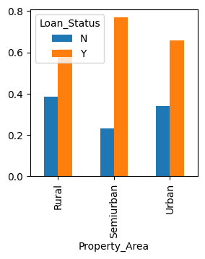
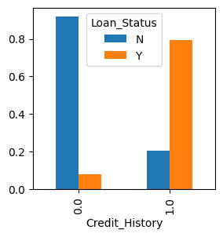
Compared to rural or urban areas, semi-urban areas have a higher percentage of loans authorized.

Slide 14
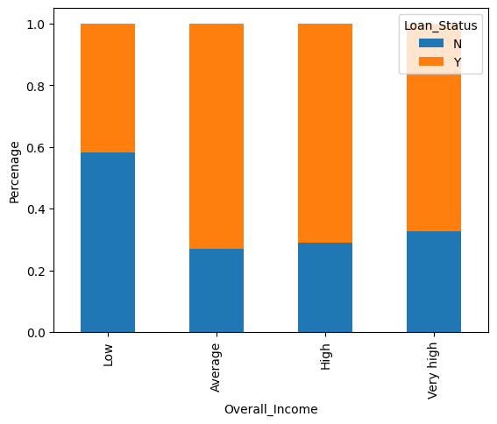
As can be observed, the percentage of accepted loans is higher for low and average loan amounts than it is for high loan amounts, which confirms our theory that smaller loans have a higher probability of being granted.

Slide 15
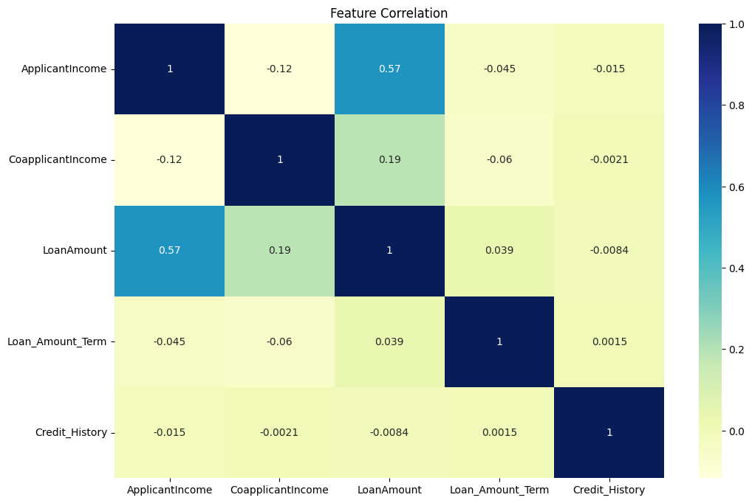
Applicant income has a major affect on the loan status whereas the Co- Applicant income has a minor impact.

Slide 16
MODEL BUILDING
Models Used:
Logistic Regression
Random Forest
Decision Tree
Naive Bayes
XG Boost
KNN
SVM
Target Variable: Loan_Status

Slide 17
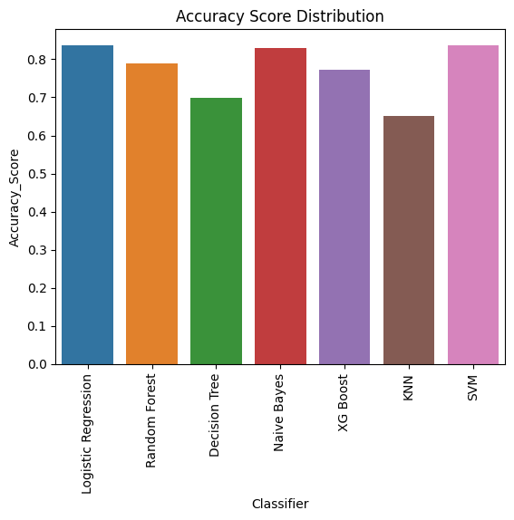
Among all the models, Logistic Regression and SVM worked best with 83.9% of accuracy

Slide 18
CONCLUSION
The features dataset with all the information including from the gender to the credit history been a helping hand in extracting the accurate information in analysis if an applicant is eligible to fulfill the needs( Housing, Electronics, Education etc.,) and also played a major role in extracting the useful insights.

Slide 19
REFERENCES
https://medium.com/mlearning-ai/univariate-bivariate-and-multivariate-data-analysis-in-python-341493c3d173
https://realpython.com/logistic-regression-python/
www.analyticsvidhya.com

Slide 20
Thank you!!

